Slide 3
Pioneer
Champions
Influencers
Hesitaters
Obstructers

Slide 4
Laws tend to be developed reactively rather than proactively

Slide 5
ROLE
PURPOSE
MOTIVATIONS
IDENTIFIES AS
SELF-TALK/ BEHAVIOR
CHANGE-DRIVEN ACTIONS
This is wrong.
How do I make this right?
What can I do to lead?
Clarify your vision
Make it safe for everyone to join you.
Create and cast a Vision for Change
Bring out the best.
Empowered
PIONEER
You bring structure and organization. You make it as inclusive as possible.
You celebrate every incremental step forward.
Support the Vision & Plan for Change
Being on a winning team.
What can I do to help?
How can I add value?
CHAMPIONS
Supportive
Carry the message to the community
Light other candles
How can I spread the word? How can I get others to join in?
How can I take this further?
Can you bring your voice alive? Can you move with intention & purpose?
Moving people to action; peacemakers
Enthusiastic
INFLUENCERS
Wait and see
Watch from a distance
Is this safe for us/me?
Let’s wait and see.
Don’t stick your neck out.
What’s one thing you can do? Can you risk getting it wrong?
Keeping status quo.
Not rocking the boat.
Responsible
HESITATERS
This won’t work. Here we go again. Waste of time/ money. We don’t have this problem.
Can you be open minded to a new idea? Can you seek understanding? Can you declare noble intent? If you can’t be for, don’t be against.
Be obstructive to change.
Fear of change, the unknown, or being wrong.
Right
OBSTRUCTERS

Slide 6
DISENGAGED EMPLOYEES IS COSTLY
Research by Accenture found that 98% of leaders think employees feel their company is inclusive. In other words, leaders think employees can bring their whole, authentic selves to work.
But only 80% of employees actually report feeling included in their workplaces.
This gap of about 20 percentage points is called the "perception gap."
Closing the "perception gap," or making more employees feel included, could save employers millions and boost US company profits by a whopping $1.05 trillion.

Slide 7
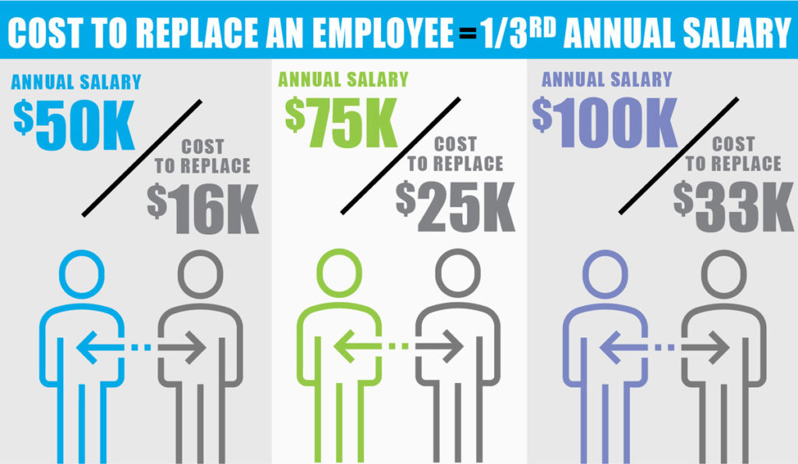

Slide 8
KNOW THE LAW
Age Discrimination in Employment Act (ADEA)
Sections 501 and 505 of the Rehabilitation Act
American with Disabilities Act (ADA)
Family Leave and Medical Act (FMLA)
Equal Pay Act (EPA)
1963
1964
1967
1972
1973
1978
1990
1991
1993
Civil Rights Act
Equal Employment Opportunity Act
Civil Services Reform Act (CSRA)
Civil Rights Act

Slide 9
YOUR ANOTHER SEAT AT THE TABLE LICENSE COMPLETE TEACHING PACKAGE
Instructional Facilitator & Participant Guides
Lunch & Learn Scripts
Complete Mastermind Guides
Instructor-Led Content by Two Professional Trainers

Slide 10
YOUR ANOTHER SEAT AT THE TABLE LICENSE COMPLETE TEACHING PACKAGE
INSTRUCTOR-LED TRAINING
VICKI CLARK
Speaker, trainer, facilitator, mentor and consultant
Specialty:
Helping organizations take an active approach to inclusion and dismantling
oppression.
JOSH RICH
Corporate trainer, speaker, facilitator and mentor
Specialty:
Providing training, tools and resources to help organizations build diverse and inclusive teams.
Military Communications Banking
Technology Medical Manufacturing

Slide 11
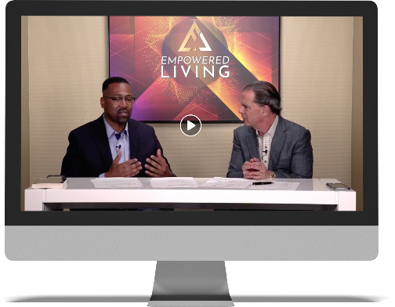
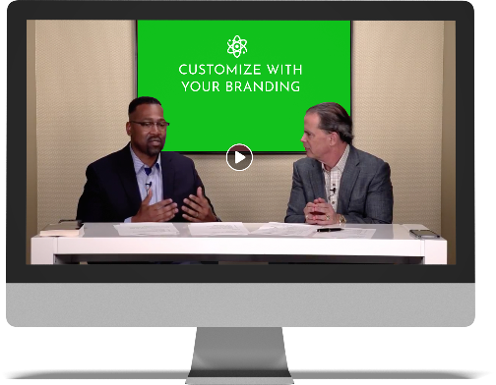
YOUR ANOTHER SEAT AT THE TABLE LICENSE COMPLETE TEACHING PACKAGE
READY-TO-USE VIDEO LESSONS
EMPOWERED LIVING BRANDING
EDIT WITH YOUR BRANDING
(upgrade option)

Slide 12
YOUR ANOTHER SEAT AT THE TABLE LICENSE COMPLETE TEACHING PACKAGE
Instructional Facilitator & Participant Guides
Instructor-Led Content by Two Professional Trainers
Animated Videos Illustrating Core Teaching Concepts
Complete Mastermind Guides
Customizable Plug and Play Video Lessons
PowerPoint Presentations
Lunch & Learn Scripts
Word-for-Word Teaching Scripts
Diversity & Inclusion Pre-Test
EEOC Laws/Regulations (link & downloadable PDF)
Data Points, Studies & Statistics (link & downloadable PDF)

Slide 13
YOUR ANOTHER SEAT AT THE TABLE LICENSE COMPLETE SALES & MARKETING PACKAGE
Get a Suite of Branded, Downloadable and Customizable Tools!
Diversity & Inclusion workplace poster
PCIHO card that you can print and leave with your clients
Sales Scripts (cold call, emails, sales conversation/ presentation)
Promo graphics, flyers, quote graphics, and advertising graphics
Another Seat at the Table promo video (sizzle reel)
*with UPGRADE option to customize

Slide 14
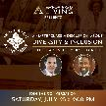
YOUR ANOTHER SEAT AT THE TABLE COMPLETE DIVERSITY & INCLUSION PROGRAM LICENSE
1 payment of
$ 997
3 payments of
$ 400
Get instant access to the complete suite of resources as soon as they are released.
Get access to digital content with deposit, and access to the full program (including downloadable resources), once paid in full.
OR
BONUS TRAINING:
Live sales training class with Paul teaching you how to sell this program for onsite or virtual training.

